Slide 1
Beast Mode
Chafic Charafeddine - Remy Dillenseger - Gregory Douglas - Jose Medina

Slide 2
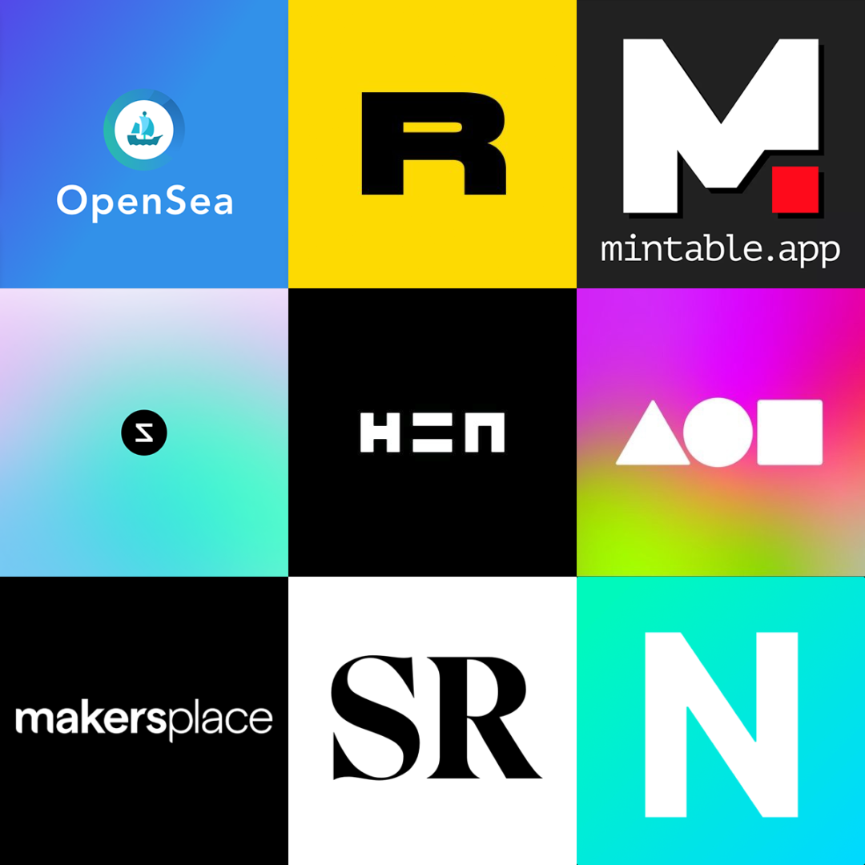
A Marketplace Near You
Our goal was to be able to create a Marketplace dApp where people could register new artwork, view other people's collection, and have the option to buy and sell there NFTs all in one place.

Slide 3
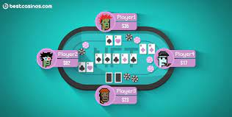
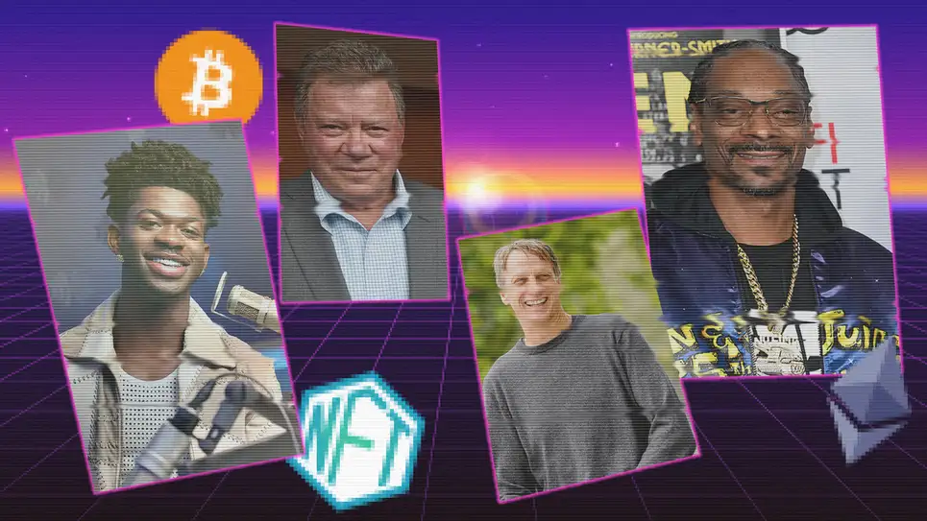
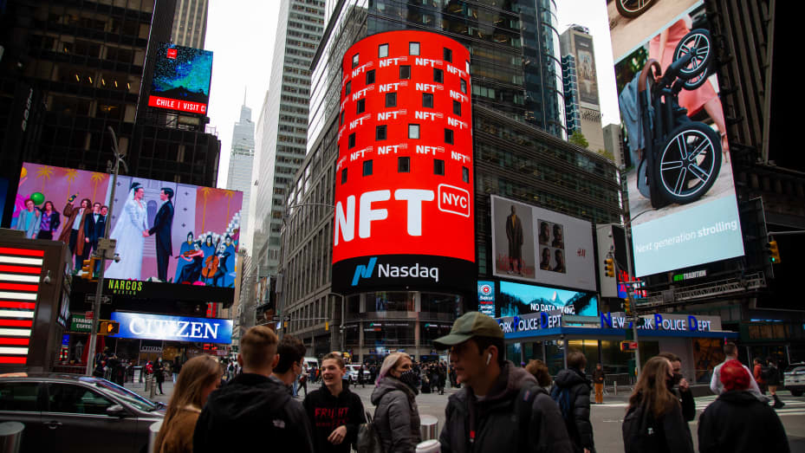
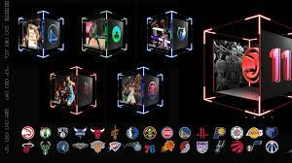
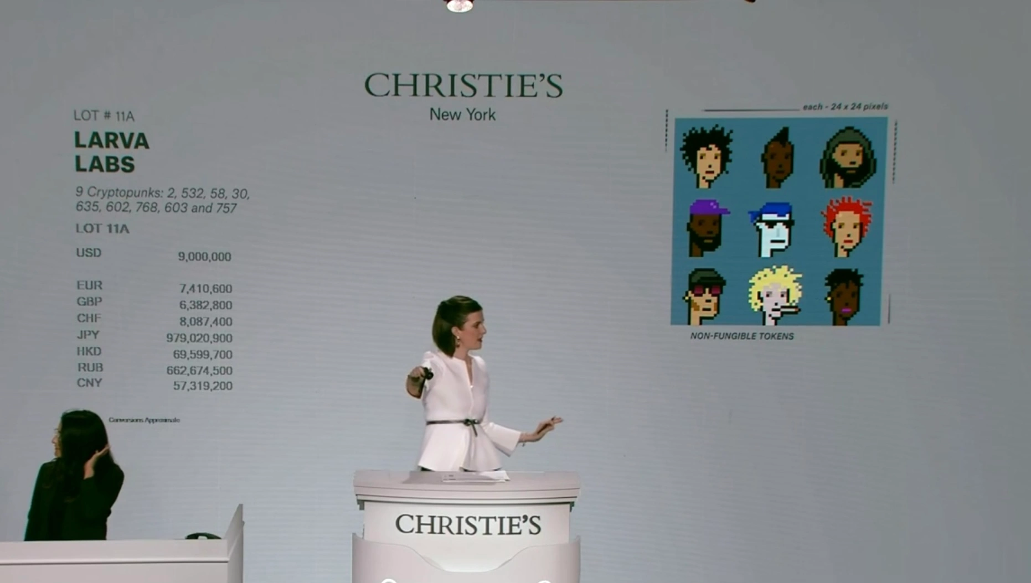

NFTs Everywhere

Slide 4
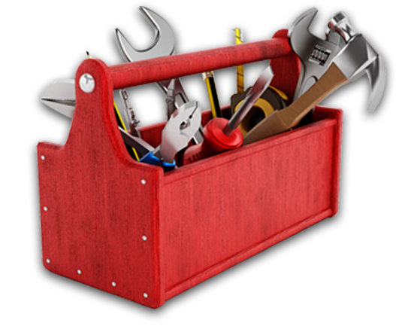
Tools of the Trade
Pinata
Streamlit/pages
Metamask
Ganache
Web3
Remix
This Photo by Unknown author is licensed under CC BY-NC.

Slide 5

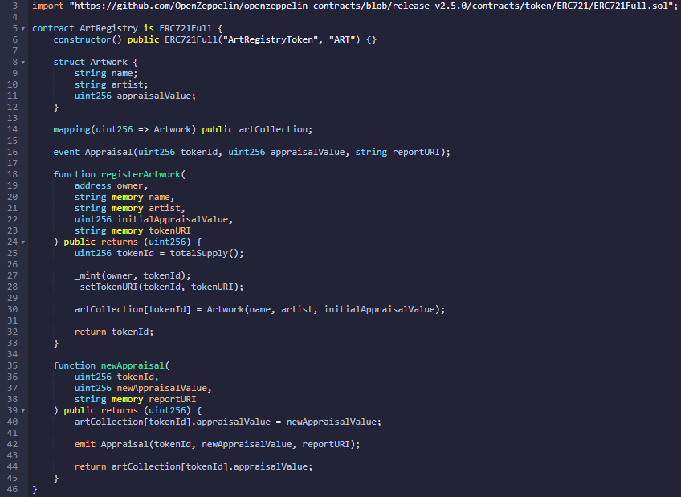

Slide 6
Demo

Slide 7


Challenges
Interpreting output from pinata
IPFS loading speed
ERC-721 token protocols

Slide 8

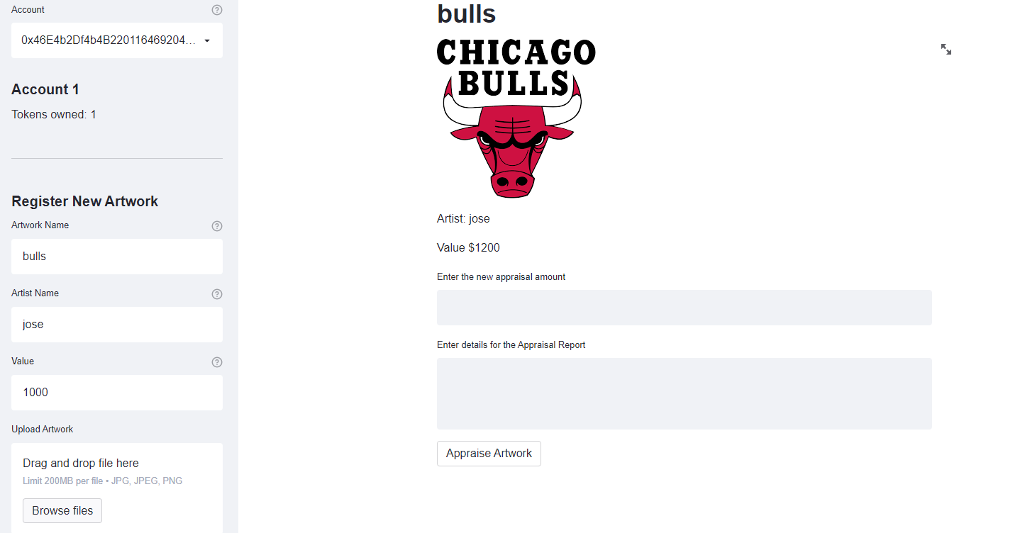
What's Next?

Slide 9

Security Improvements

Slide 10

Streamlit upgrade
Eth mainnet
Buy/sell functionality
Cosmetic improvements
Improving picture load speed
Deploying (containerizing)

Slide 11
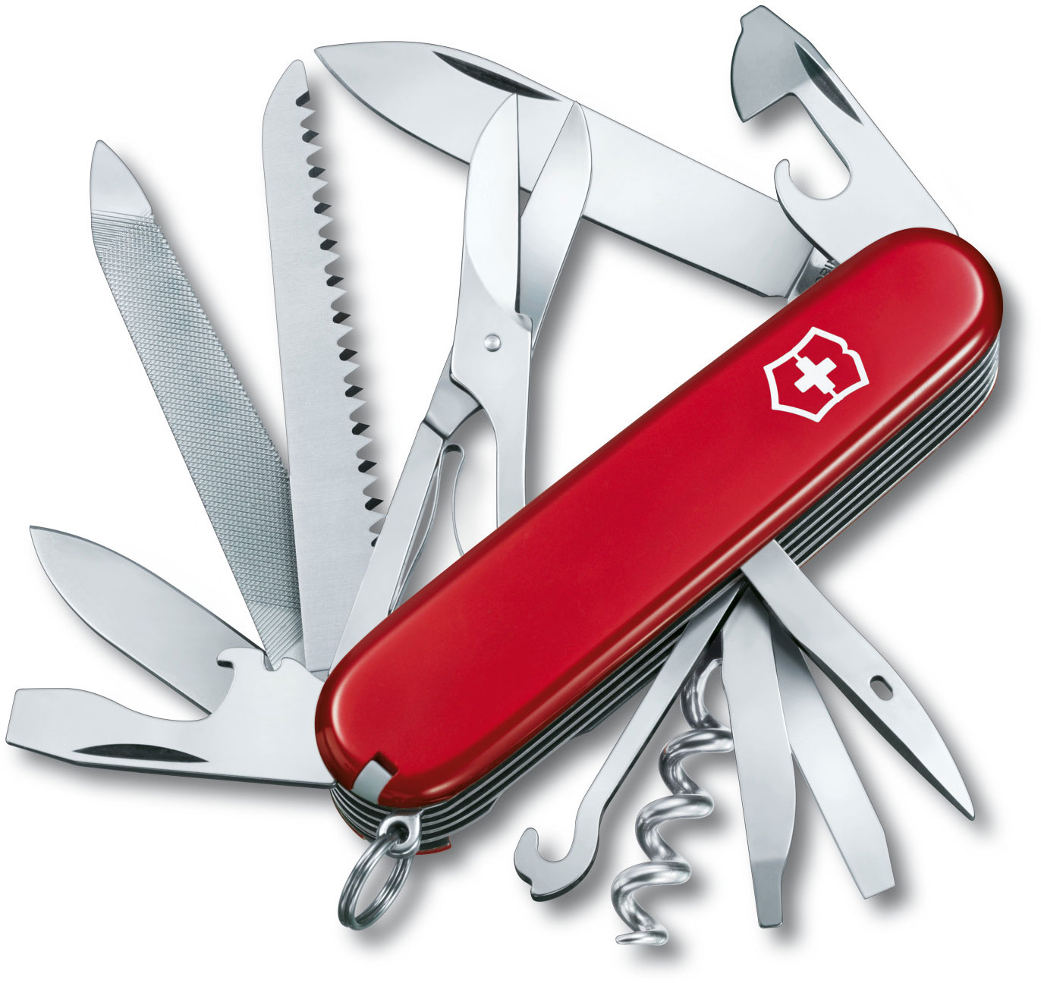
Extra Functions
Royalties, fee exemption and discounts
Access (membership, community,events)
Distribution of rewards
Flash loans

Slide 12
Fin

Slide 15
Mercury is the smallest planet
Mars is a cold place

Slide 21
Marketing Icons

